Slide 1
Presenters: Alexander Gaskins and Phong Mai
Euratom Nuclear Program:
From Day 1 to Now

Slide 2


What is Euratom?
Notes:
On March 25th, 1957, the European Atomic Energy Community was established following a series of other European Communities that were implemented in the 1950’s that would assist in the later formation of the European Union in 1993.
In the Italian city of Rome, the Euratom treaty was signed with the belief that nuclear power was the key energy technology of the future. The treaty signified the collaboration of member nations in the nuclear energy industry.
As individual nations, availability of fissile materials and expertise was not enough to keep up with the sudden rise in nuclear prominence all throughout the world, but collectively, supplies could be distributed among member nations.
But this was not an overnight process.

Slide 3

How it Began
After World War II, the United States took a strong interest in the economic and political integration of Europe.
Secretary of State George C. Marshall saw European integration as the most viable solution to the problem of what to do with Germany.
Notes:
It all started after World War II, when the United States took a strong interest in the economic and political integration of Europe. Secretary of State George C. Marshall saw European integration as the most viable solution to the problem of what to do with Germany.
Integration was also seen as the best way to strengthen Western European economic and political resistance to communism, as Euratom would provide competition to the expansion of the Soviet Union. In fact, before becoming president, Dwight D. Eisenhower called for European unity because he believed it was the best way to provide security for the Continent.

Slide 4



European Communities
European Coal and Steel Community
(Founded 1952)
European Economic Community
(Founded 1957)
European Atomic Energy Community
(Founded 1957)
Notes:
Prior to the formation of the European Union, a collection of European Communities were formed under different categories. Namely, the European Coal and Steel Community, European Economic Community and European Atomic Energy Community. All of which, focused on hosting an inclusive market where development and trading could take place between different countries in specific areas of interest.
Energy was a key area that was of utmost importance. The desire to have access to affordable and trustworthy energy sources, especially in the post war era, played a large role in the establishment of the European Coal and Steel Community. However, because coal is not unlimited, the deposits were on a steady track towards total depletion. In addition, the political situation following the Suez Crisis in 1956 “made all of Europe more power conscious and more receptive to the joint development of atomic energy.”

Slide 5
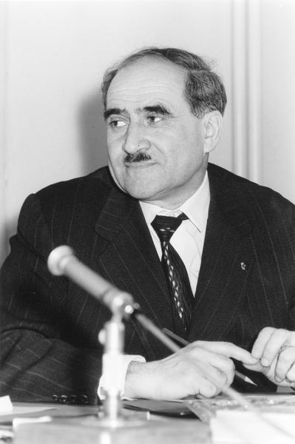
Louis Armand
Well-respected French engineer
Greatly inspired the formation of Euratom
Was the chair of Euratom between 1958 and 1959
Notes:
Following the conclusion of the second world war, Louis Armand, a successful French engineer, was tasked with conducting a study into the chance of nuclear energy use in Europe. His report decided that further nuclear development was necessary in order to fill the deficit left by the exhaustion of coal deposits and to reduce dependence on oil producers.
His conclusions greatly inspired the decision to establish the European Atomic Energy Community, resulting in his appointment as the chair of Euratom.

Slide 6
The Purpose of Euratom
A single market focused on trading nuclear materials and technology
Notes:
In the 1950s, nuclear energy was seen as a very promising source of energy. The original Member States believed that the development of nuclear energy would pave the way for economic prosperity in Europe, and even open up a new industrial revolution.
Furthermore, Europe was short of domestic energy supplies, which made it dependent on foreign sources. The availability of imported energy was uncertain, and this threatened not only Europe’s economic growth, but also its political security. Because technology is heavily equated with a nation’s power, Euratom would also provided drastic improvements to the overall status of the European Community.
The end goal was to essentially turn Europe into a third world power, independent of the United States, with its own rivaling grasp on nuclear technology.

Slide 7
“Peaceful” Nuclear Energy
Euratom aimed to promote the use of nuclear fission for peaceful use through
Research Funding
Fission Technology
Clean Energy
Notes:
The ultimate goal was to push the initiative of peaceful nuclear energy following the recent race to the atom bomb in World War II. It was no secret that nuclear energy offered promising results with energy production, but in order to promote it, the name of nuclear energy needed to be shifted away from its militaristic counterpart, being the atomic bomb.
The development of new technologies was seen as the only solution for a situation with scarce supply that threatened to become an obstacle to economic growth. However, the cost of conducting research and constructing reactors was too high for individual member states to bear separately. It was realized that the cost had to be shared, and the duplication of efforts avoided.

Slide 8
A Need for Enriched Uranium
In the 1950’s, the United States by far dominated the nuclear industry. With their influence on the formation of Euratom, the following was possible:
1. Provided information on nuclear energy technology
2. Supplied enriched uranium for nuclear reactors
Notes:
The United States not only had the most advanced technology, but, together with the United Kingdom, it was also controlling the world supply of uranium. An agreement made between the United States and Belgium, granting the U.S. access to uranium and in exchange, Belgium received information on nuclear energy technology, as well as enriched uranium for nuclear reactors.
For France, it was crucial that the privileges under the bilateral agreement between the United States and Belgium could be transferred to the Euratom framework, as France wanted access to the United States’ technological information and nuclear materials. Because the United States immensely supported Euratom, they declared that the uranium would be available to the Euratom Member States and they would also get access to technological information from the United States.

Slide 9

Military Influence
Developed nuclear military technology in secret, free from scrutiny by national Parliaments
Link between development of civil nuclear technology and military technology was so close that same secrecy was often involved
These links resulted in little monitoring and control requirements in the Euratom Treaty
Notes:
Despite having public interest in mind, influence from militaristic nuclear methods led to much of the initial research and work being done in secrecy to avoid scrutiny from national parliaments.
Since almost all prior research was done with military technology, the two sectors were closely linked with one another. As a result of this bias, the Euratom Treaty was initially quite lenient on monitoring and control requirements when it came to research and development.

Slide 10
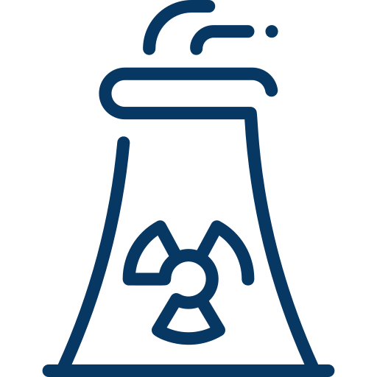

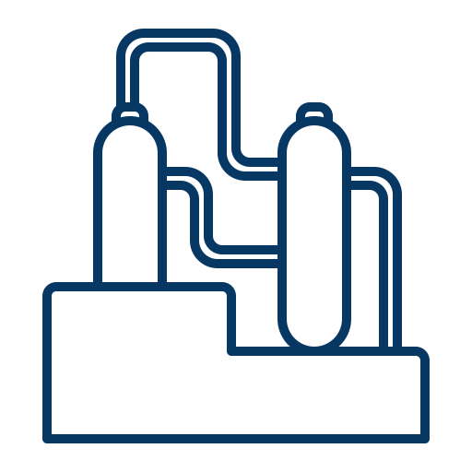
Reactor War
First Type:
Gas/Graphite Reactors
Third Type:
Boiling Water Reactors
Second Type:
Pressurized Water Reactors
Notes:
At the end of the 1950s, there were three main types of power reactors for commercial use: the gas/graphite reactors, the pressurized water reactors, and the boiling-water reactors. The first type used natural uranium as fuel, while the other two used enriched uranium.
While natural uranium was relatively cheap and easily obtainable, enriched uranium was more expensive, and had to be imported; the Member States had no domestic source of enriched uranium.
France used the first type and wanted the Euratom to draw on this (French) technology instead of relying on foreign (American) technology. France argued that the Member States could secure its energy supply by using natural uranium gas/graphite reactors, as there would then be no need to import fuel.
But some Member States were concerned about the French dominance in the nuclear technology field, and preferred to use American technology to close the gap between them and France.
To accommodate for the cost of enriched uranium, the U.S. laid out a joint five-year research program as well as a large-scale programme for the construction of American patent reactors. Eight enriched uranium reactors were to be supplied by American manufacturers. Under this agreement, the United States not only guaranteed the enriched uranium supply, but also provided a loan to the Euratom to facilitate the financing of the reactors.

Slide 11

European Union (EU)
In 1993, the European Union was established, effectively replacing the previously discussed European Community (EC).
Euratom remained separate from the European Union, being the only previously established EC’s to do so
Link between development of civil nuclear technology and military technology was so close that same secrecy was often involved
Notes:
In 1993, the European Union was established, effectively replacing the previously discussed European Community. The European Union proposed one single market that has been established through a standardized system of laws that apply in all member states in those matters, and only those matters, where the states have agreed to act as one.
But what did this mean for Euratom?
Euratom remained legally distinct from the European Union although it has the same membership, and is governed by many of the EU's institutions. It is the only remaining community organisation that is independent of the EU and therefore outside the regulatory control of the European Parliament.
Following this momentous occasion, Euratom continued to supply roughly 30% of the EU’s energy and ensured that Europe’s nuclear plants were operated safely and guaranteed a secure supply of nuclear fuel.

